Slide 1
Wisabi Bank ATM Transactions Report
Wisabi Bank is a leading financial institution in Nigeria, headquartered in Lagos with branches in Kano, Rivers State, Enugu, and FCT Abuja.
Wisabi Bank provides a wide range of financial services to its customers, including savings accounts, current accounts, loans, and investments.

Slide 2
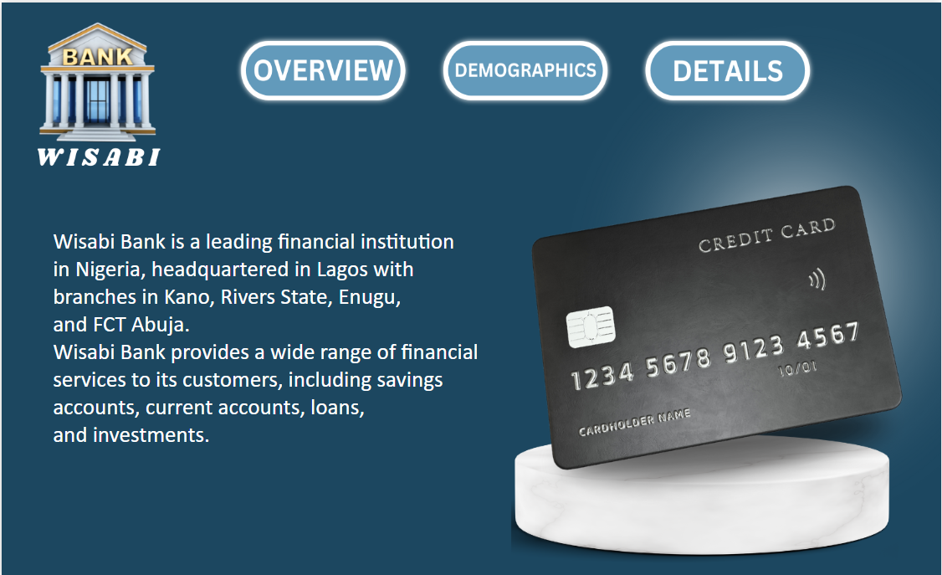

Slide 3
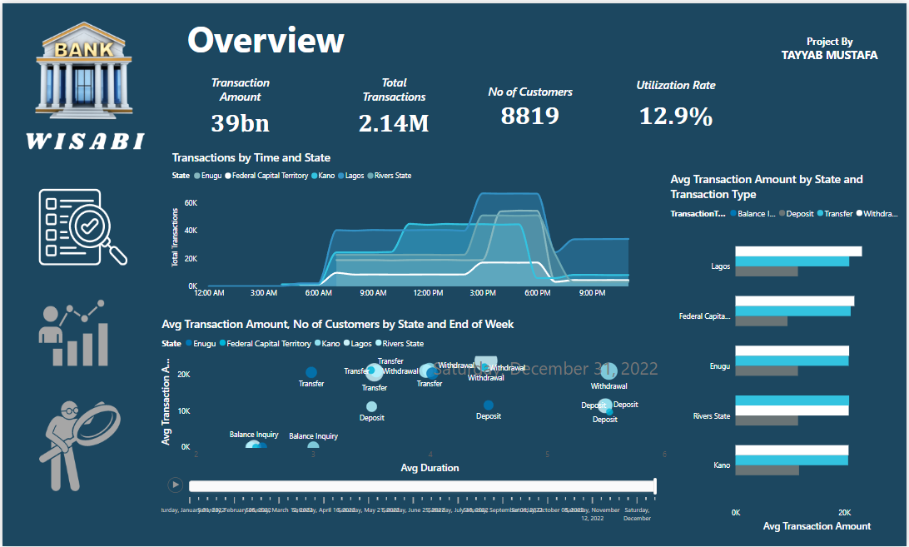

Slide 4
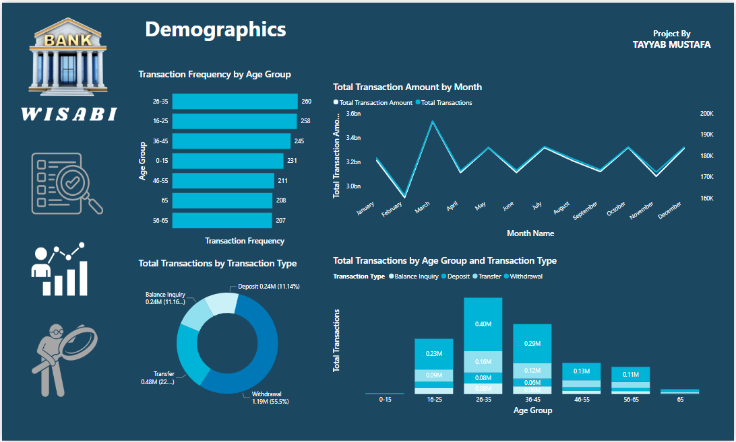

Slide 5
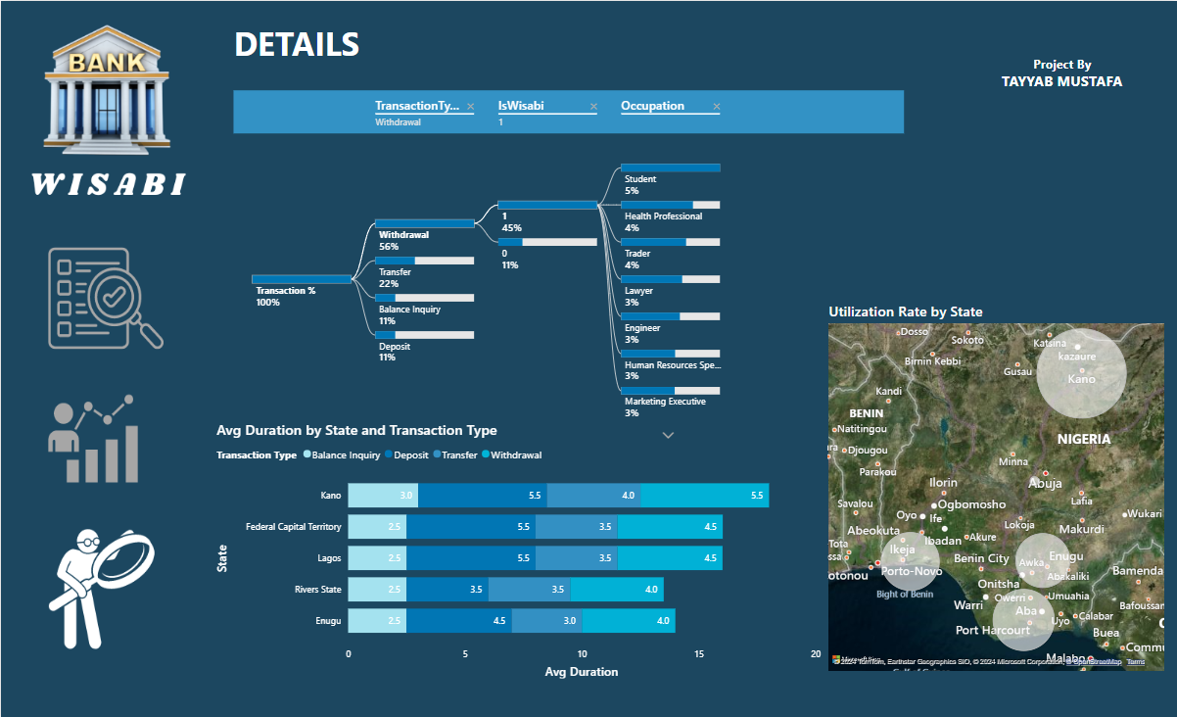

Slide 6
Total amount processed by Wisabi ATMs in 2022
₦38,555,885,000
Number of Transactions Processed
2,143,838
Unique persons who carried out at least one transaction
8819
Utilization Rate
12.9%

Slide 7
Daily Transaction Trend
ATM Transactions in Lagos increase gradually from 6 am and peaks between 3 and 7 pm.
Similar behavior is seen across other states however transactions peak earlier in Kano

Slide 8
Amount vs Duration
ATM Transactions in Lagos increase gradually from 6 am and peaks between 3 and 7 pm.
Similar behavior is seen across other states however transactions peak earlier in Kano

Slide 9
Avg Transaction Amount
On Average, Withdrawals have the highest transaction amounts across all states.
Next is Transfers, with Deposits have the lowest.

Slide 10
Transaction Amount & Count
March has the highest number of transactions and transaction amount.
While February has the lowest number of transactions and transaction amount.

Slide 11
Utilization Rate
ATMs in Kano have the highest Utilization Rate (18.6%)
Rivers & Lagos have Utilization Rates greater than 12% (12.7% & 12.2% respectively) while that for Enugu is 11.6%
The FCT has the lowest Utilization Rate (8.5%)

Slide 12
My Recommendations
Utilization Rate is very low in FCT
Make sure that the ATMs are visible and accessible to customers. This could involve relocating the ATMs to more prominent locations.
Offer incentives to customers such as waived transaction fees or cashback rewards.

Slide 13
Average Transaction Duration in Kano is longer
Increase the number of ATMs available in the branch.
Consider upgrading the ATMs to newer models with faster transaction times and more advanced features.
Ensure that the ATMs are regularly serviced and maintained to prevent downtime.

Slide 14
Transaction Activity
ATMs should have maximum availability especially during the peak activity periods for each bank branch.
Scheduled maintenance should coincide with these periods of reduced activity.
ATMs have significantly reduced activity in the early and late hours of the day

